Slide 1

$http service

Slide 2
What is $http?
$http is a service that facilitates communication with the remote HTTP servers via the browser's XMLHttpRequest object
The $http API is based on the deferred/promise APIs exposed by the $q service

Slide 3
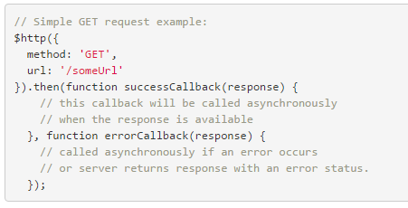
General usage
Call $http with a configuration object -> the returned object is a promise that will be resolved when the request succeeds or fails

Slide 4
General usage
The configuration object can have a lot of property, the main ones are:
method – {string} – HTTP method (e.g. 'GET', 'POST', etc)
url – {string|TrustedObject} – Absolute or relative URL of the resource that is being requested; or an object created by a call to $sce.trustAsResourceUrl(url).
params – {Object.<string|Object>} – Map of strings or objects which will be serialized with the paramSerializer and appended as GET parameters.
data – {string|Object} – Data to be sent as the request message data.
headers – {Object} – Map of strings or functions which return strings representing HTTP headers to send to the server. If the return value of a function is null, the header will not be sent. Functions accept a config object as an argument.
Full list: https://docs.angularjs.org/api/ng/service/$http#usage

Slide 5
General usage
The promise is resolved with a response object
data – {string|Object} – The response body transformed with the transform functions.
status – {number} – HTTP status code of the response.
headers – {function([headerName])} – Header getter function.
config – {Object} – The configuration object that was used to generate the request.
statusText – {string} – HTTP status text of the response.
The “real” response vody content is under the data property

Slide 6

Shortcut syntax
Some simple shortcuts methods exists:
$http.get -> arguments: url & configuration
$http.head -> arguments: url & configuration
$http.post -> arguments: url, data & configuration
$http.put -> arguments: url, data & configuration
$http.delete -> arguments: url & configuration
$http.jsonp -> arguments: url & configuration
$http.patch -> arguments: url & configuration
The configuration object is always optional

Slide 7
Shortcut syntax
Note on the shortuc syntax:
Only POST & PUT can have some a data payload
=> DELETE cannot have a data payload
=> Your API must have url-based resource identification
For exemple http://myhostname/api/todos/23

